Slide 1

Enhancing Personalization in Banking: A Data-Driven Approach
Data Science Mid-term Project

Slide 2
Team Members:
Dwaraka
Harshita
Nuthan
Jayakrishna

Slide 3
Problem Statement:
Traditional banking services lack personalization, leading to customer dissatisfaction and missed cross-selling opportunities.

Slide 4




Solution Overview:
Our Solution: Leveraging advanced data science techniques to analyze customer behavior and preferences for tailored banking services.

Slide 5
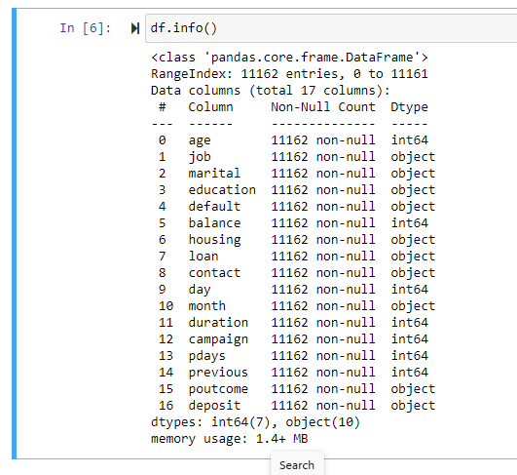
Data Overview:
Data Sources: Customer transaction history, Loan history, demographic data, and online behavior.

Slide 6
Methodology:
Machine Learning Algorithms: Predictive analytics, clustering, and recommendation systems.
Unique Approach: Utilizing deep learning for sentiment analysis on customer feedback.

Slide 7
Future Challenges & Risks
Volume Management: It can be overwhelming to deal with a lot of notifications, making it challenging to prioritize and properly reply to each one.

Slide 8
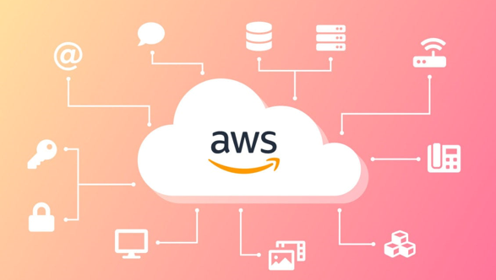

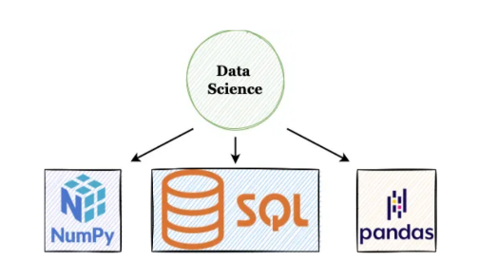
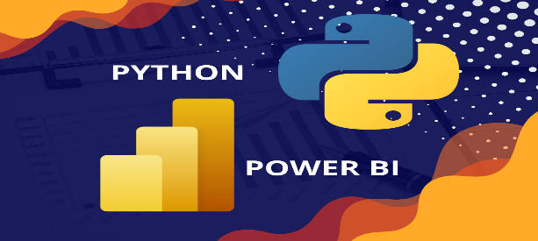
Data Science pipeline:
Data source(Kaggle)
Python for Data Engineering(NumPy, Pandas.. Library) and SQL
Python for Data Visualization(Matplotlib library)
Power BI for Visualization and Reporting
Data Analysis(AI & Machine Learning)
Python Flask for web Development
Deploy(Any Cloud Server like AWS)

Slide 9
Sources:
Data sources: https://www.kaggle.com/datasets/janiobachmann/bank-marketing-dataset/data

Slide 10
Thank you...

